Slide 1

KAPASA MAKASA UNIVERSITY
Research Methods (AA400/ AA300)
Lecture II – Research proposal
Mrs Sarah Ng’andwe Tembo
Dept of Agric and Aquatic sciences
March 2026

Slide 2
Research proposal
The research proposal is a document that provides a logical presentation of a research idea, reveals the significance of the idea and illustrates the activities of the proposed research work
Generally, a research proposal should contain all the key elements involved in the research process.

Slide 3
All research proposals must address the following questions:
What do you plan to accomplish?
Why do you want to do it?
How are you going to do it?

Slide 4
The proposal should have sufficient information to convince your readers that you have an important research idea, that you have a good grasp of the relevant literature and the major issues, and that your methodology is sound

Slide 5
Format for BSc Research Proposal
Title of thesis – front page
Name of student, Id and year – front page
Table of contents
Introduction, problem statement, justification, objectives (General objective and specific objectives) and hypothesis/ research questions and scope of the study → Chapter one
Literature review → Chapter two
Methodology – study area, sampling technique, Data analysis → Chapter three
Workplan
Budget
References
Appendices

Slide 6
Pages and font
Maximum number of pages should not exceed 20.
The thesis should be written using
  Times New Roman, the font size fixed at 12 points.

Slide 7
Structure of the research proposal
A research proposal has four main components:
A) The preliminary pages
B) The main body which has three chapters
C) The references
D) Appendices

Slide 8
Essentials of a research proposal
Cover/Title
The title should be informative, specific and concise, emphasizing the main point(s) of your planned research.
The title must be short, simple and easy to be understood by a person who is not an expert in the field.
It is advisable to formulate title after statement of the problem
The title is stated at the top of the page, followed by the students full names and year

Slide 9
Table of content
This page consist the list of chapters and subunits with their respective page numbers
Ensure there is coherence between the page number and content in that page

Slide 10
1.1 Background information
Give the background to the proposed research and give an up to date summary of scholarly knowledge in the field of the proposal.
The purpose of this section is to establish the significance of your research ideas.
This should summarize the background information of the problem to be researched and the context within which it will be studied.
The literature reviewed normally covers global, regional and local perspectives
Literature reviewed must be recent and close to the area or topic under investigation. Meaning the literature reviewed should not be more than 10 years

Slide 11
1.2 Problem statement
Clearly define the problem (practical, scientific, or intellectual).
Show evidence and facts proving the problem is important.
Provide a brief literature review: what has been done, what gaps remain.

Slide 12
1.3 Justification
Explain the importance of your research: contribution to knowledge, solutions, or socio-economic development
State the usefulness of the research results by making clear the rationale for doing it and how the results will help to improve the previous situation or contribute to formulation of interventions to address the problem more effectively
  E.g the purpose of this study is to..

Slide 13
The justification of a research project explains why the study is important and why it should be carried out.
It demonstrates the value of the research in contributing to knowledge, solving practical problems, or informing policy and practice. A well-justified study shows how the results will benefit stakeholders, such as farmers, fish farmers, livestock keepers, or the scientific community

Slide 14
1.4 Objectives
Objectives summarize what is to be achieved and must be closely related to statement of the problem
General
  What is expected to be achieved by the study in general terms
Specific (what is expected to be achieved in specific terms)
  What?
  Where?
  For what purpose?
Each specific objective must closely relate to general objective
Last objective should focus on how the results will be used

Slide 15
Formulating of objectives
Research objectives define what a study intends to achieve. They guide the entire research process
Research objectives help the researcher stay focused and guide the study in the required direction. Without clear objectives, research can easily become scattered and unfocused

Slide 16
1.4 Objectives
Objectives are statements of the results that should be measurable and observable at the end of a research process.
The overall objective states the strategic goal(s) to which the solution of the stated research problem(s) shall contribute.
The specific objectives tell exactly what the researcher expects to do.

Slide 17
Characteristics of good objectives
Research objectives should be SMART
Specific – Focus on a clear aspect of the problem.
Measurable – Must be possible to assess or quantify.
Achievable – Within the available time, resources, and scope
Relevant – Directly related to the main research problem.
Time-bound– Defines the study period or conditions.

Slide 18
Stating objectives (SMART)
Phrase in operational terms
Use action verbs
  Determine
  Compare
  Verify
  Calculate
  Describe
  Establish
NOT
  Appreciate
  Understand
  study

Slide 19
1.5 Research questions
These are investigative questions that the researcher would like to answer by the research
Should correspond or be in line with the objectives
Should be in the order of the research questions
  Use terms such as …what is….how does...

Slide 20
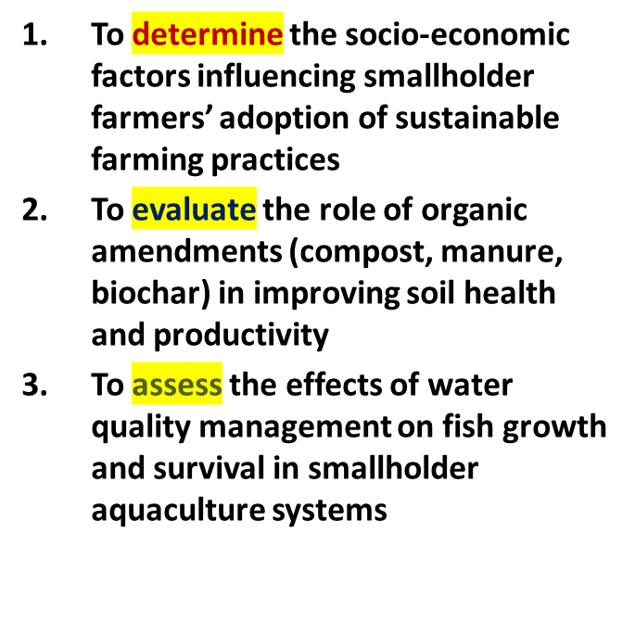
Research questions and objectives
Specific objectives
Research questions
What socio-economic characteristics (income, education, farm size) influence farmers’ decisions to adopt sustainable farming practices?
How do different organic amendments affect soil health and productivity?
How do parameters such as pH, dissolved oxygen, and turbidity influence fish growth and survival rates?

Slide 21
Hypothesis formulation and testing
Hypothesis is a prediction of a relationship between one or more factors and the problem under study that can be studied
It is a proposed explanation for an observable phenomenon
A question is converted into a statement that can be scientifically investigated
Make some educated guess about how things work based on your experience and understanding of the subject area of interest
This educated guess about the answer to your question is called HYPOTHESIS
It is a prediction of the relationship between one or more factors and the problem under study that can be tested

Slide 22
Forms of hypotheses
If hypotheses are used, there are two forms: null and alternative.
A null hypothesis represents the traditional approach: it makes a prediction that in the general population, no relationship or no significant difference exists between groups on a variable. The wording is, “There is no difference (or relationship)” between the groups.

Slide 23
The second form, is the alternative hypothesis
proposition or belief that the independent variable in an experiment will have an effect on the dependent variable.

Slide 24
Hypotheses Testing
Effects of nitrogen fertilizer application on maize yield
H(0)-Null Hypothesis
Nitrogen fertilizer application has no effect on maize yield
H(1) -Alternative Hypothesis
Nitrogen fertilizer has an effect on maize yield.

Slide 25
Key Issues
The hypothesis should be
  Relevant
  Reasonably “narrow” in scope
  Testable in the time available
  Measurable (qualitatively or quantatively)
  Should address only one issue
  Should address only one issue and involve only one clause
    (do not use “and”, “or”, ‘If”, “when”, “but”, “therefore”, “because”

Slide 26
What are the criteria of a good hypothesis?
Should have conceptual clarity and a theoretical orientation.
It should be testable. It should be stated in a suitable way so that it can be tested by investigation.
It may be accepted or rejected
It must be clearly stated in the research report

Slide 27
Expressing a Hypothesis
Express the hypothesis using independent variables (the variable you change during the experiment) and your dependent variables (variable you observe changes which are influenced by changes in the independent variable).
The change in the dependent variable is explained or is dependent on the independent variable.

Slide 28
Objectives and hypothesis
Objectives
Hypothesis
To determine the effect of nitrogen fertilizer application rates on maize yield (kg/ha)s
To examine the effect of dissolved oxygen levels on fish survival rate
Nitrogen fertilizer application rates have a significant effect on maize yield (kg/ha).
Dissolved oxygen levels have a significant effect on fish survival rate (%).

Slide 29
Objectives and Hypothesis
Objectives
Hypothesis
To investigate the effect of weeding frequency on bean yield (kg/ha)
To determine the effect of mineral supplementation on daily milk yield (litres/day) in cows
Weeding frequency has a significant effect on bean yield (kg/ha
Mineral supplementation has a significant effect on daily milk yield (litres/day) in cows

Slide 30
Example
Suppose you’re testing whether organic amendments (compost, manure, biochar) improve crop yield compared to chemical fertilizer:
H₀: Organic amendments have no effect on yield.
H₁: Organic amendments increase yield.
If your statistical test gives p = 0.03, you reject H₀ and conclude that organic amendments significantly improve yield.

Slide 31
Literature Review
Shows awareness of existing research and current knowledge.
Demonstrates that the study will make a significant contribution to the field.
Deepens understanding of the research problem.
Helps identify gaps in knowledge to be filled.
Connects existing knowledge with the proposed research, showing how the study goes beyond what is known.
Brings together data from different sources to allow new or clearer conclusions.

Slide 32
Methodology
Location & population: Describe and justify where and with whom the study will be conducted.
Methods description: Provide clear, concise details to show expertise (avoid unnecessary detail).
Resources: Mention facilities, equipment, and other resources available

Slide 33
Sampling
Define the sampling frame.
State and justify the sample size and how it was determined.
Explain sampling procedures.
Study Methods
Describe and justify study methods and laboratory analysis (include references if applicable).If using questionnaires, specify key information to be collected.

Slide 34
Data Management & Analysis
Explain how data will be coded, managed, and analyzed.
Mention the statistical package to be used.
State the experimental design, statistical models, and tests to be performed

Slide 35
Work plan
Present a time schedule for the activities to be performed and milestones to be achieved i.e. a time-delivery flow chart of achievements.
Describe the entire period of the study including preparation of the proposal, submission and approval, training (where necessary), pre-testing (of the study tools), data collection, data analysis, report preparation, and dissemination of the findings. A gaunt chart may also be drawn

Slide 36
Budget
List the items you request funding for in the budget and their cost.
The budgetary items should include such items as equipment's (type and costs), expandable supplies (chemicals, drugs, glassware, stationery) literature (books, journals, internet service), travel (fares and places to be visited), and personnel cost (researchers, technicians, assistants, casual laborer).

Slide 37
References
APA and Harvard are the common referencing styles in agricultural sciences, using author-year citations.
The references should be arranged alphabetically
Reference citations in the text should be typed by writing only the author’s surname and the year of publication as follows:
Leguminous tree leaves and their pods can be used as alternative protein sources to replace fishmeal and soybean in fish diets (Sayed, 2025; El-Saidy and Gaber, 2023). OR
According to Sayed (2025) and El-Saidy and Gaber (2023) leguminous tree leaves and their pods can be used as alternative protein sources to replace fishmeal and soybean in fish diets.

Slide 38
For three or more authors, include only the name of the first author plus et al.
e.g. Leguminous tree leaves and their pods can be used as alternative protein sources to replace fishmeal and soybean in fish diets (Richter et al., 2003; Kaushik et al., 2004). OR
According to Richter et al. (2003) and Kaushik et al.(2004) leguminous tree leaves and their pods can be used as alternative protein sources to replace fishmeal and soybean in fish diets .
Provide a list of all references cited in the text of the proposal.
Make sure that all references cited are listed in the references and that all references listed are cited in the text of the proposal.

Slide 39
Example of writing reference list
Citation of papers published in Journals
El-Saidy D.M.S.D. and Gaber M.M.A. (2003). Replacement of fish meal with a mixture of different plant protein sources in juvenile Nile tilapia (Oreochromis niloticus, L.) diets. Aquaculture Research 34 (13):1119-1127.
Citation of individual chapters in multi-authored books
• Green, B.N.W., K.L. Veverica and M.S. Fitzpatrick. (1997). Fry and fingerlings production. In: Dynamics of Pond Aquaculture (editors Egna, H. and C. Boyd), pp: 215 – 243. CRC Press, Boca Raton, Florida, USA.

Slide 40
Citation papers in Proceedings of conferences
Mboera, L.E.G. and Kitaly, J.I. (1994). Diseases of small ruminants in central Tanzania. In: Proceedings of the second biennial conference of the African Small Ruminants Research Network, 7-11 December 1992, AICC Arusha, Tanzania, pp 117-120.
Citation of thesis
Ngoly, T.M. (2009). Assessment of heavy metals and agrochemical residues in ruminant feeds and milk. MSc. Dissertation, Sokoine University of Agriculture, Morogoro, Tanzania. pp 74.

Slide 41
Citation of papers from electronic sources
Lin, C.K. 1996. Clarias and Tilapia interaction in polyculture.
http://pdacrsp.oregonstate.edu/pubs/nops/ful_rprts /96-94.pdf. Accessed on 26 January 2011.

Slide 42
Tips and Tricks
Read and read
Take notes
Talk to supervisors, experts, fellows
Write topics and topics
Get confused, get afraid
Generate a number of research questions
Systematize research questions
Cut down these in line with your coherent thinkings

Slide 43
Common Mistakes
To provide context to frame research question(s)
To delimit the boundary of research issue(s)
To cite landmark studies undertaken so far
To present accurate theoretical background of the study
To focus the research questions(s)
To develop coherent and persuasive arguments
Too much detailed or too much short on major issues
Too much rambling – going all over without clear cut sense of direction
Incorrect citation/references
Too long or too short

Slide 44
DOs and DO NOTs
DO
Produce/prepare a professional looking proposal
Make it interesting
Make it informative, meaningful
Write easy way to read
Present content in a page
Use clear headings/sub-headings
Be concise, precise
Check spelling, grammar
Present in accurate/acceptable format
DO NOTs
Use no ward which you do not understand
Use of difficult ward unimpressive to the readers/supervisor/authoruty

